Slide 1
A Cluster-Weighted Kernel K-Means Method for Multi-View Clustering
Abbas Mehrbanian
M.Sc Artificial Intelligence
Reza Tahmasbi
M.Sc Artificial Intelligence

Slide 2
Multi-view clustering
It assumes different views of a dataset have a common clustering partition. which means the corresponding instances in different views belong to the same cluster.
Why MVC?
Simply concatenating features from different views into a single one?!
results in poor performance, since it ignores the heterogeneity of different feature spaces and may lead to dimension curse

Slide 3
Multi-view clustering methods
The general idea of these algorithms is to guarantee the consistency among different views by using common cluster discrimination information, which can be expressed by:
Common eigenvector matrix for multi-view spectral
Common coefficient matrix for multi-view subspace clustering
Common indicator matrix for multi-view nonnegative matrix factorization clustering

Slide 4
What’s the goal?
Low-quality views may degrade the performance if equally using all available views.
“view-weighted methods”
PROBLEM: Cannot discover more detailed information within the view.
👉 Different clusters in a view may quite vary in the degree of intra-cluster similarity
SOLUTION: Cluster-Weighted Kernel K-Means method for multi-view clustering

Slide 5
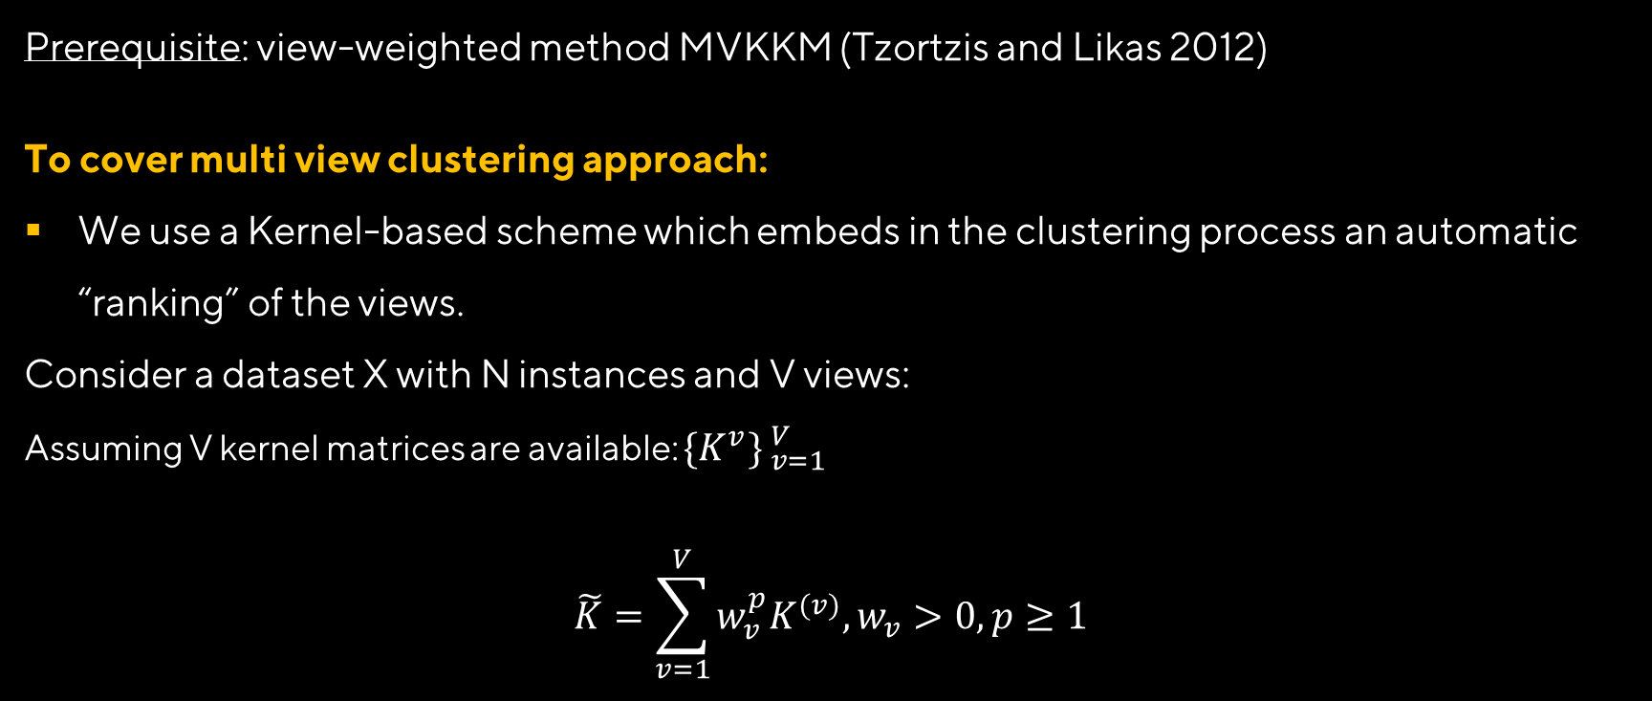
Implementation of CWKKM
Prerequisite: view-weighted method MVKKM (Tzortzis and Likas 2012)
To cover multi view clustering approach:
We use a Kernel-based scheme which embeds in the clustering process an automatic “ranking” of the views.
Consider a dataset X with N instances and V views:
Assuming V kernel matrices are available: ${\{K^{v}\} }_{v=1}^{V}$
$$\tilde{K}=\sum_{v=1}^{V}{w_{v}^{p}K^{(v)}, w_{v}>0, p≥1}$$

Slide 6

Implementation of CWKKM (Cont.)
We expanded this scheme to our need:
$$\tilde{K}=\sum_{v=1}^{V}{\sum_{k=1}^{K}{w_{vk}^{p}K_{k}^{(v)},}w_{vk}>0, p≥1}$$

Slide 7


Implementation of CWKKM (Cont.)
Objective function of MVKKM:
$$\min_{w_{v},U,μ_{k}^{(v)}}{\sum_{v=1}^{V}{w_{v}^{p}\sum_{k=1}^{K}{\sum_{i=1}^{N}{U_{ik}{\left\|φ^{\left(v\right)}\left(x_{i}^{\left(v\right)}\right)−μ_{k}^{(v)}\right\|}^{2}}}}}$$
An indicator variable with $U_{ik}$ = 1 if $x_{i}∈C_{k}$and 0 otherwise
$$μ_{k}^{(v)}=\frac{\sum_{i=1}^{N}{U_{ik}φ^{\left(v\right)}\left(x_{i}^{\left(v\right)}\right)}}{\sum_{i=1}^{N}{U_{ik}}}$$
Centroid of the kth cluster in vth view

Slide 8
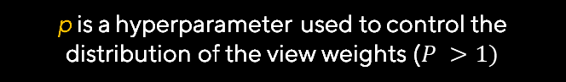

Implementation of CWKKM (Cont.)
Objective function of CWKKM:
$$\min_{w_{v},U,μ_{k}^{(v)}}{\sum_{v=1}^{V}{\sum_{k=1}^{K}{w_{vk}^{p}\sum_{i=1}^{N}{U_{ik}{\left\|φ^{\left(v\right)}\left(x_{i}^{\left(v\right)}\right)−μ_{k}^{(v)}\right\|}^{2}}}}}$$
When p → 1, only the best cluster in each set of corresponding clusters is selected,
and when $p → ∞, w_{vk}$on corresponding clusters tend to be equal.
p is a hyperparameter used to control the distribution of the view weights ($P >1)$

Slide 9
Goal?
Extracting distinctive invariant features
Correctly matched against a large database of features from many images
Invariance to image scale and rotation
Robustness to:
Affine distortion,
Change in 3D viewpoint,
Addition of noise,
Change in illumination.

Slide 10
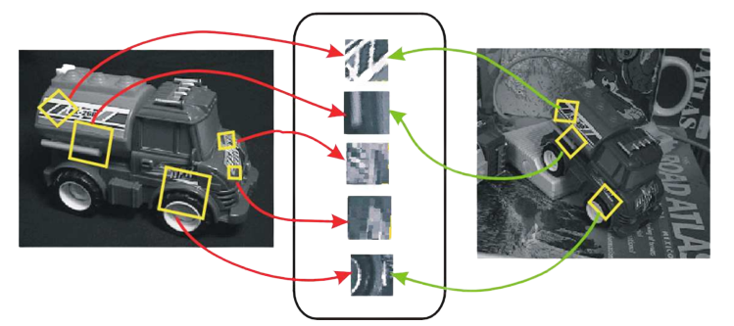
Invariant Local Features
Image content is transformed into local feature coordinates that are invariant to translation, rotation, scale, and other imaging parameters
SIFT Features

Slide 11
Advantages of invariant local features
Locality: features are local, so robust to occlusion and clutter (no prior segmentation)
Distinctiveness: individual features can be matched to a large database of objects
Quantity: many features can be generated for even small objects
Efficiency: close to real-time performance
Extensibility: can easily be extended to wide range of differing feature types, with each adding robustness

Slide 12
Steps for Extracting Key Points
Scale space peak selection
Potential locations for finding features
Key point localization
Accurately locating the feature key points
Orientation assignment
Assigning orientation to the key points
Key point descriptor
Describing the key point as a high dimensional vector

Slide 13
Scales
What should be sigma value for Canny and LG edge detection?
What should be sigma value for Canny and LG edge detection? Potential locations for finding features
Marr-Hildreth:
Spatial Coincidence assumption:
Zero crossings that coincide over several scales are physically significant.

Slide 14
Scale-Space Filtering (Witkin, 1983)
Apply whole spectrum of scales
Plot zero crossings vs scales in a scale-space

Slide 15
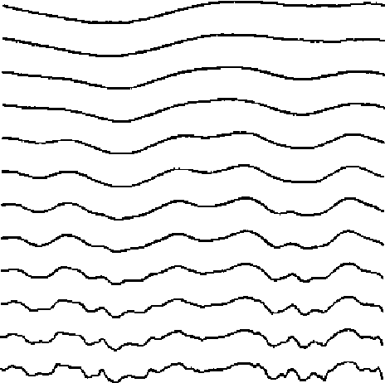
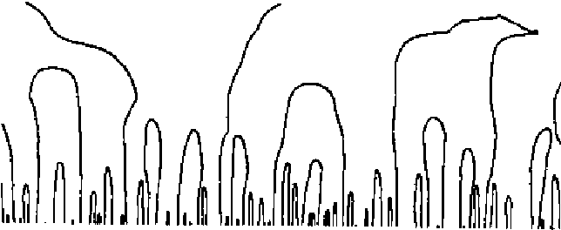
Scale-Space Filtering
Scale
Scale
contours of Fxx = 0 (zero crossings) in a scale-space image
A sequence of gaussian smoothings of an image

Slide 16
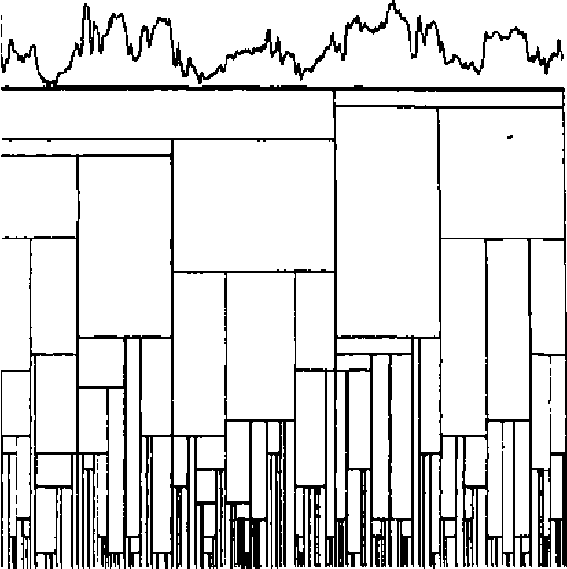
Scale-Space Filtering
Scale
Scale
Scape-Sapce
A signal with its interval tree, represented as a rectangular tessellation of scale-space.

Slide 17
Scale-Space Filtering
Apply whole spectrum of scales
Plot zero crossings vs scales in a scale-space
Interpret scale space contours
Contours are arches, open at the bottom, closed at the top
Interval tree
Each interval corresponds to a node in a tree, whose parent node represents larger interval, from which interval emerged, and whose off springs represent smaller intervals.
Stability of a node is a scale range over which the interval exits.

Slide 18
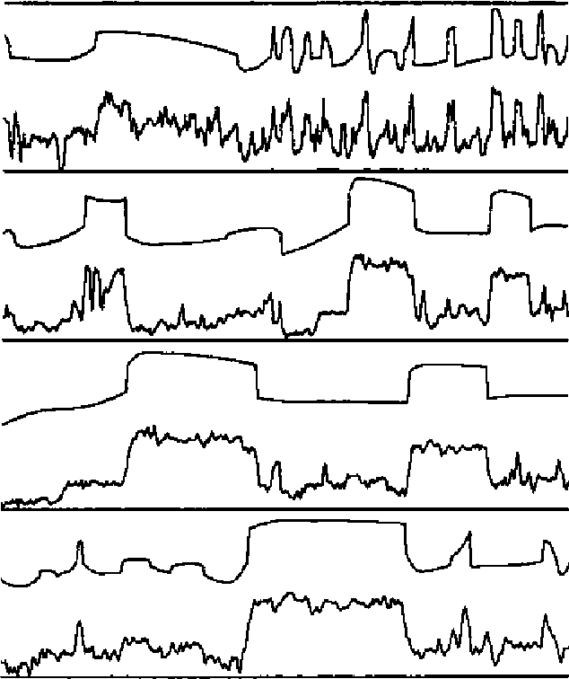
Scale-Space Filtering
Top level description
Iteratively remove nodes from the tree, splicing out nodes that are less stable than any of their parents and off springs
Several signals, with their maximum-stability descriptions. These are "top-level" descriptions, generated automatically and without thresholds. You should compare the descriptions to your own first-glance "top-level" percepts, (the noisy sine and square waves are synthetic signals.)

Slide 19
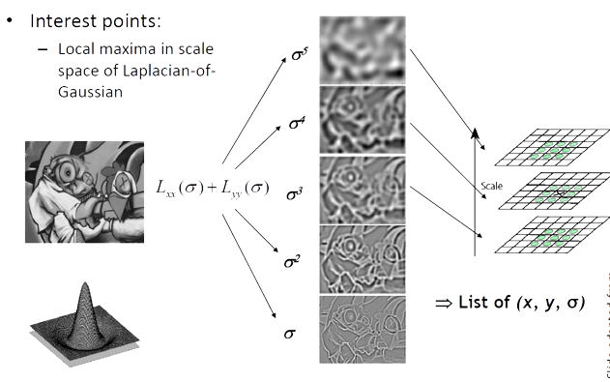







Laplacian-of-Gaussian (LoG)
Interest points:
Local maxima in scale space of Laplacian of Gaussian
$$σ^{5}$$
$$σ^{4}$$
$$L_{xx}\left(σ\right)+L_{yy}(σ)$$
$$σ^{3}$$
$$σ^{2}$$
$$⇒List of (x,y,σ)$$
$$σ^{1}$$

Slide 20
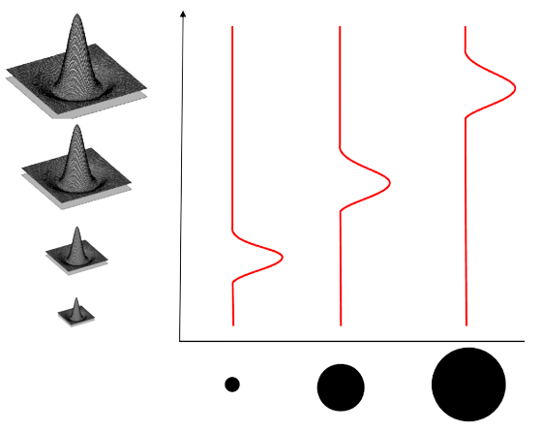
What Is A Useful Signature Function?
Laplacian-of-Gaussian = “blob” detector

Slide 21
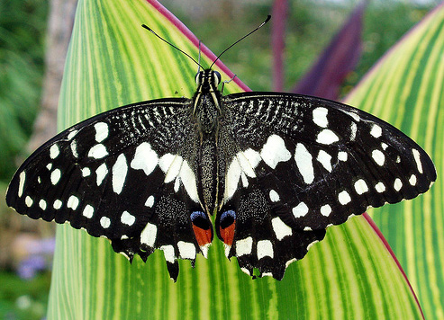
Scale-space blob detector: Example

Slide 22
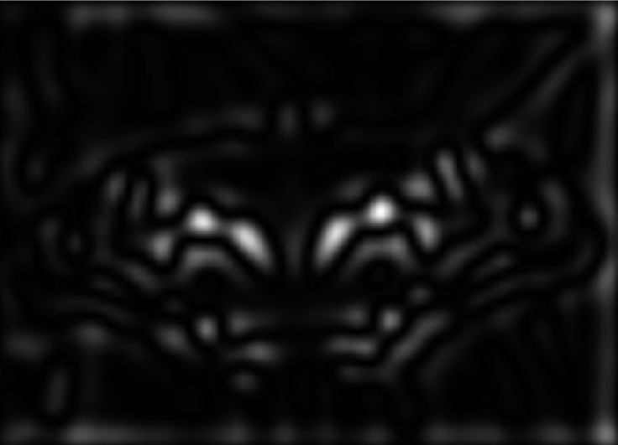
Scale-space blob detector: Example
Sigma = 11.9912

Slide 23
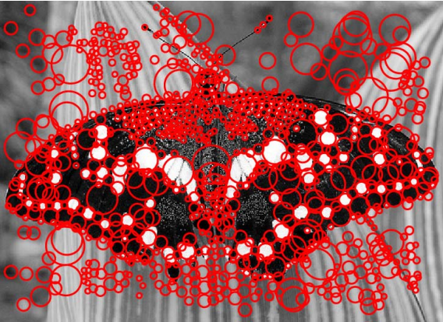
Scale-space blob detector: Example

Slide 24
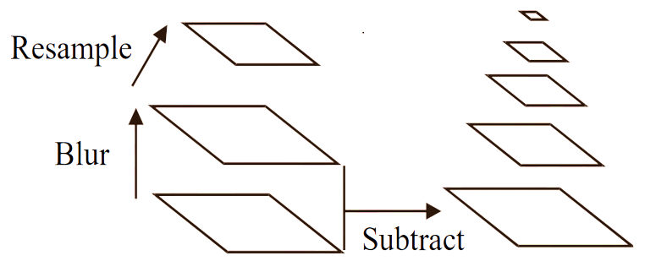
Building a Scale Space
All scales must be examined to identify scale invariant features
An efficient function is to compute the Laplacian Pyramid (Difference of Gaussian) (Burt & Adelson, 1983)

Slide 25


Approximation of LoG by Difference of Gaussians
Heat equation:
$$\frac{∂G}{∂σ}=σ∆^{2}G$$
$$σ∆^{2}G=\frac{∂G}{∂σ}=\frac{G\left(x,y,kσ\right)−G(x,y,σ)}{kσ−σ}$$
$G\left(x,y,kσ\right)−G(x,y,σ)≈(k−1)$ $σ^{2}∆^{2}G$
$$Typical values:σ=1.6, k=\sqrt{2}$$

Slide 26
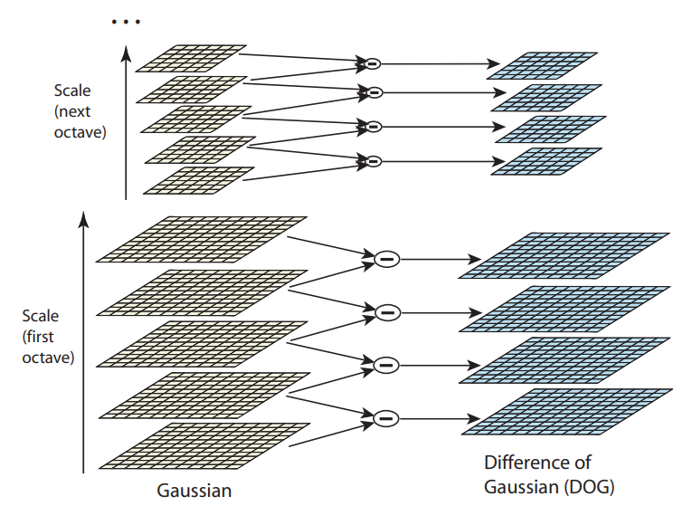
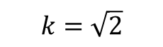
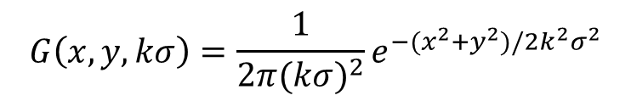
Building a Scale Space
$$G\left(x,y,kσ\right)=\frac{1}{2π{(kσ)}^{2}}e^{−(x^{2}+y^{2})/2k^{2}σ^{2}}$$
$$k=\sqrt{2}$$

Slide 27
Building a Scale Space
 | Scale
Octave | 0.707107 | 1.000000 | 1.414214 | 2.000000 | 2.828427
 | 1.414214 | 2.000000 | 2.828427 | 4.000000 | 5.656854
 | 2.828427 | 4.000000 | 5.656854 | 8.000000 | 11.313788
 | 5.656854 | 8.000000 | 11.313788 | 16.000000 | 22.627417
$$σ=\text{0}\text{.}\text{7071}87, k=\sqrt{2}$$

Slide 28
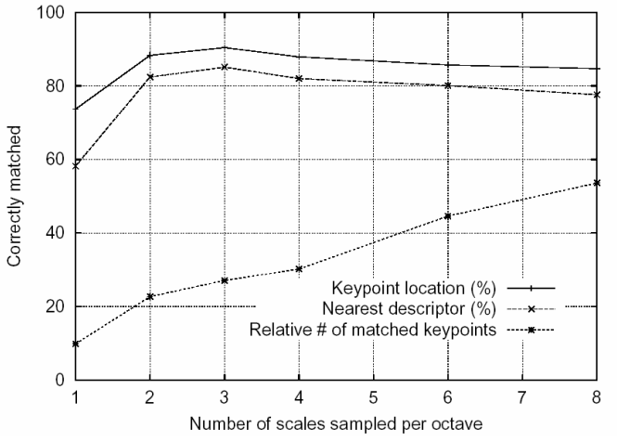
How many scales per octave?
Sampling frequency for scale
More points are found as sampling frequency increases, but accuracy of matching decreases after 3 scales/octave

Slide 29
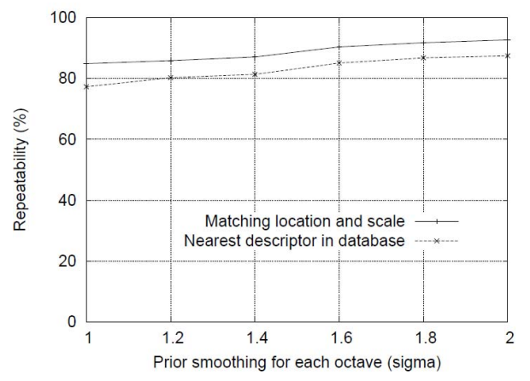
Initial value of sigma

Slide 30
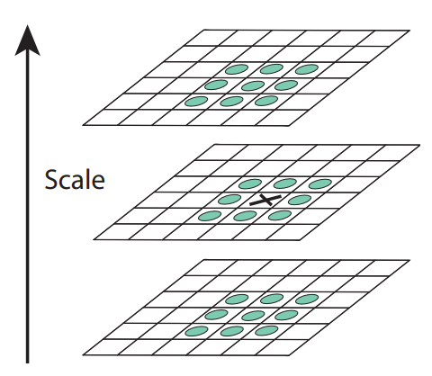
Scale Space Peak Detection
Compare a pixel (X) with 26 pixels in current and adjacent scales (Green Circles)
Select a pixel ( X) if larger/smaller than all 26 pixels
Large number of extrema, computationally expensive
Detect the most stable subset with a coarse sampling of scales.

Slide 31
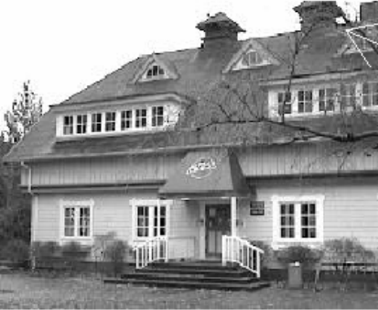
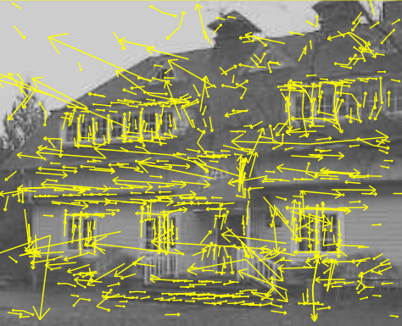
Key Point Localization
Candidates are chosen from extrema detection
Original image (233x189)
832 DOG extrema locations

Slide 32





Initial Outlier Rejection
Low contrast candidate
Poorly localized candidates along an edge
Taylor series expansion of DOG, D
Minima or maxima is located at:
Value of D(x) at minima/maxima must be large, $|D(x)|>th$.
$$D\left(X\right)=D+\frac{∂D^{T}}{∂X}X+\frac{1}{2}X^{T}\frac{∂^{2}D^{T}}{∂X^{2}}X$$
$$X={(x,y,σ)}^{T}$$
$$\hat{X}=−{\frac{∂^{2}D}{∂X^{2}}}^{−1}\frac{∂D}{∂x}$$
$$D\left(\hat{X}\right)=D+\frac{1}{2}\frac{∂D^{T}}{∂X}\hat{X}$$

Slide 33
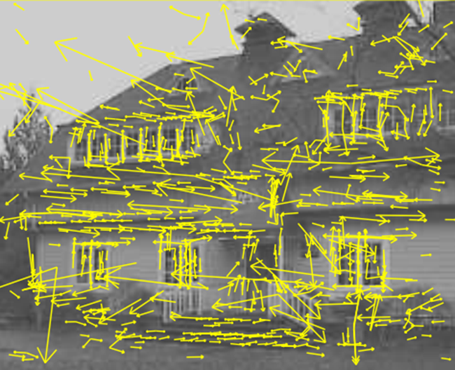
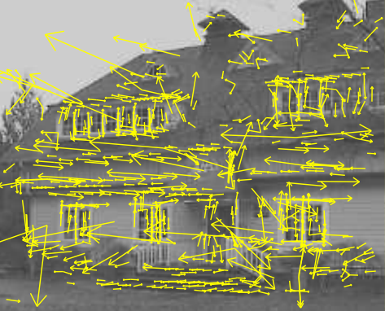
Initial Outlier Rejection
from 832 key points to 729 key points, th=0.03.

Slide 34





Further Outlier Rejection
DOG has strong response along edge
Assume DOG as a surface
Compute principal curvatures (PC)
Along the edge one of the PC is very low, across the edge is high
Analogous to Harris corner detector
Compute Hessian of D
Remove outliers by evaluating
$$H=\left[\begin{matrix}D_{xx} & D_{xy} \\ D_{xy} & D_{yy}\end{matrix}\right]$$
$$Tr\left(H\right)=D_{xx}+D_{yy}=λ_{1}+λ_{2}$$
$$Det\left(H\right)=D_{xx}D_{yy}−{D_{xy}}^{2}=λ_{1}λ_{2}$$
$$\frac{{Tr(H)}^{2}}{Det(H)}=\frac{{(r+1)}^{2}}{r}$$
$$r=\frac{λ_{1}}{λ_{2}}$$

Slide 35



Further Outlier Rejection
Following quantity is minimum when r=1
It increases with r
Eliminate key points if $r>10$
$$\frac{{Tr(H)}^{2}}{Det(H)}<\frac{{(r+1)}^{2}}{r}$$
$$r=\frac{λ_{1}}{λ_{2}}$$

Slide 36

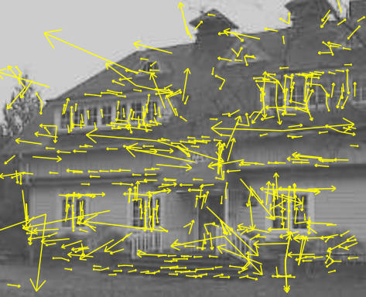
Further Outlier Rejection
from 729 key points to 536 key points

Slide 37
Orientation Assignment
To achieve rotation invariance
Compute central derivatives, gradient magnitude and direction of L (smooth image) at the scale of key point (x,y)
$$m(x,y)=\sqrt{{(L\left(x+1,y\right)−L\left(x−1,y\right))}^{2}−{(L\left(x,y+1\right)−L\left(x,y−1\right))}^{2}}$$
$$θ(x,y)=\tan^{−1}(\frac{L\left(x,y+1\right)−L\left(x,y−1\right)}{L\left(x+1,y\right)−L\left(x−1,y\right)})$$

Slide 38
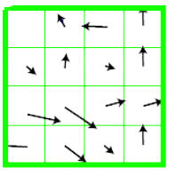
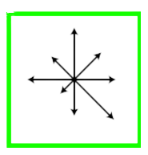

Orientation Assignment
Create a weighted direction histogram in a neighborhood of a key point (36 bins)
Weights are:
Gradient magnitudes
Spatial gaussian filter with $σ$= 1.5 x <scale of key point>
Select the peak as direction of the key point
Introduce additional key points (same location) at local peaks (within 80% of max peak) of the histogram with different directions

Slide 39
Local Image Descriptors at Key Points
Possible descriptor
Store intensity samples in the neighborhood
Sensitive to lighting changes, 3D object transformation
Use of gradient orientation histograms
Robust representation

Slide 40
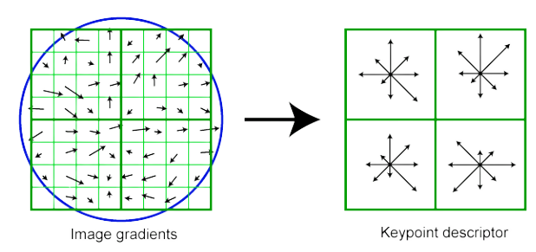
Extraction of Local Image Descriptors at Key Points
Compute relative orientation and magnitude in a 16x16 neighborhood at key point
Form weighted histogram (8 bin) for 4x4 regions
Weight by magnitude and spatial Gaussian
Concatenate 16 histograms in one long vector of 128 dimensions
Example for 8x8 to 2x2 descriptors

Slide 41
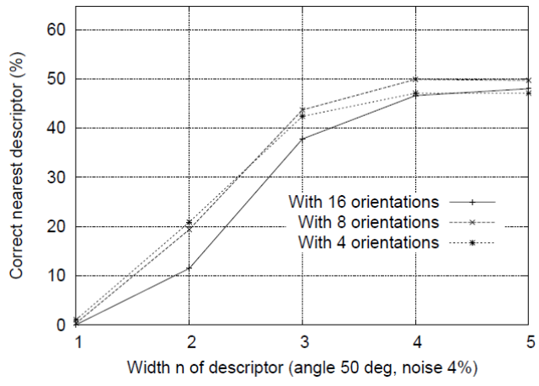
Descriptor Regions (n by n)

Slide 42
Extraction of Local Image Descriptors at Key Point
Store numbers in a vector
Normalize to unit vector (UN)
Illumination invariance (affine changes)
For non-linear intensity transforms
Bound Unit Vector items to maximum 0.2 (remove larger gradients)
Renormalize to unit vector

Slide 43
Key point matching
Match the key points against a database of that obtained from training images.
Find the nearest neighbor i.e. a key point with minimum Euclidean distance.
Efficient Nearest Neighbor matching
Looks at ratio of distance between best and 2nd best match (.8)

Slide 44
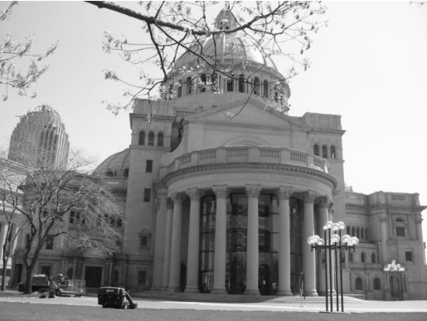
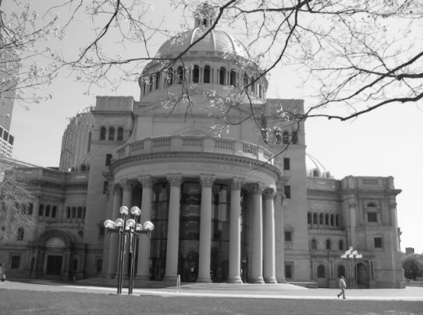
Key point matching
Image 1
Image 2

Slide 45
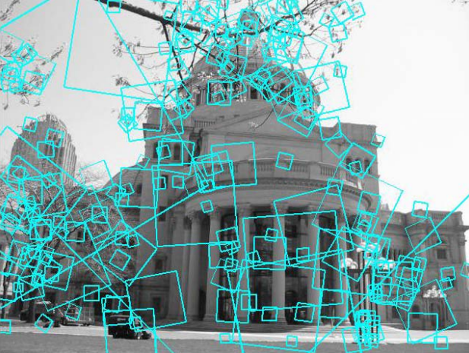
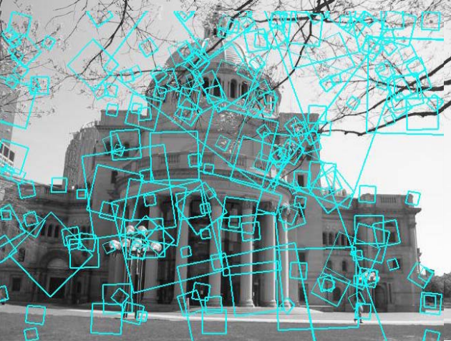
Matching local features
?
Image 1
Image 2
To generate candidate matches, find patches that have the most similar appearance or SIFT descriptor
Simplest approach: compare them all, take the closest (or closest k, or within a thresholded distance)

Slide 46
Ambiguous matches
At what distance do we have a good match
To add robustness to matching, can consider ratio : distance to best match / distance to second best match
If low, first match looks good
If high, could be ambiguous match.
Image 1
? ? ? ?
Image 2

Slide 47
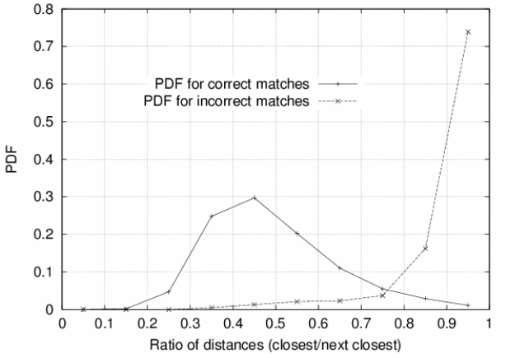
Probability of correct match
Compare distance of nearest neighbor to second nearest neighbor (from different object)
Threshold of 0.8 provides excellent separation

